Slide 1
AI applications in Finance
Lecture 3
Introduction to Neural Networks
19-Nov-2020
Indranil Dutta

Slide 2
Recap
Types of learning
Supervised learning -> classification, regression.
Unsupervised learning -> clustering, association.
Perceptron
As the simplest neural network
Has two input nodes and one output node
Has weights, linear combiner (does addition), activation function (output)
Network Architecture
Input, Hidden and Output layers
Cost function that needs to be optimized.
Gradient descend as a method for above.
Backpropagation as a method of training

Slide 3
Fun Fact : AI and movie ratings
Research being done at University of Southern California, Viterbi School of Engineering
Trained by 992 movie scripts
on risk behaviour, pattern, language
Neural Network based system
Processes semantics (meanings of words / sentences) and sentiments
New movie script
Rating for movie
Traditional way : Humans view and rate after movie has been made
New AI based approach : Rating will be made in less time, even before a single scene is shot
So appropriate changes can be made, saving time and money (profitability)
Source: University of Southern California. "AI tool may predict movies' future ratings." ScienceDaily. ScienceDaily, 17 November 2020. <www.sciencedaily.com/releases/2020/11/201117144539.htm>

Slide 4
Agenda – Session 3
Training of Neural Nets
Review of Definitions
Introduction to types of tools
Via code
Via standalone applications
Via AI platforms

Slide 5
Training of Neural Networks

Slide 6
Concepts
Have a large amount of data for training.
Helps in refining the weights and get more efficient.
Have diversity in the data set.
Should reflect the diversity expected in the input feed.
Have training data similar to operational data
Shuffle the data
Change the sequence of rows in the data set.
Source: https://www.allaboutcircuits.com/technical-articles/understanding-simple-neural-network-training-and-learning

Slide 7
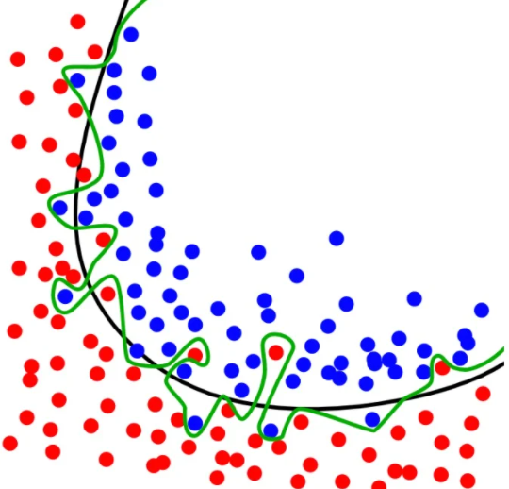
Concepts
Over Training
Network adjusts to the training set and not to the task at hand.
Classification problem Red and blue dots
Black line – captures general pattern
Green line - captures training data too accurately and is less generalized.
Source: https://www.allaboutcircuits.com/technical-articles/understanding-simple-neural-network-training-and-learning

Slide 8
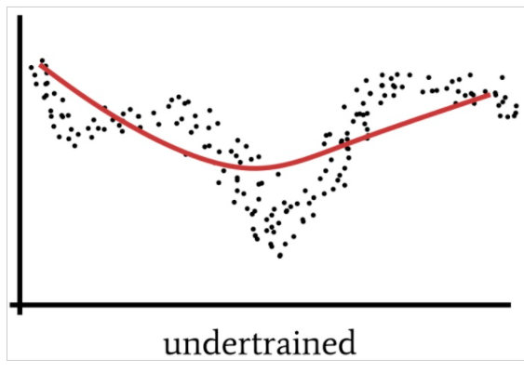
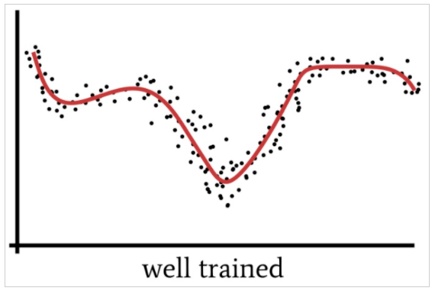
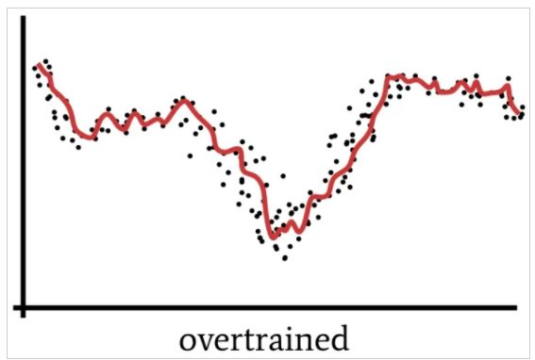
Concepts
Source: https://www.allaboutcircuits.com/technical-articles/understanding-simple-neural-network-training-and-learning

Slide 9
Review of Definitions

Slide 10
Definition Review
Learning rate (α) : Value that
controls how much to change the model
In response to the error in each step
When weights are adjusted
If too low – training process becomes long and can get stuck
If too high – weights not correct and/or network becomes unstable.
Epoch : Each complete pass through the entire training set is called an epoch.
Can use the same training set multiple times.
Delta (δ ) : Expected Output Value (from Training Set) – Actual Output Value (from Network)
Batch: The number of samples of the training set processed before updates are made.
Source :https://machinelearningmastery.com/understand-the-dynamics-of-learning-rate-on-deep-learning-neural-networks/, https://www.allaboutcircuits.com/technical-articles/how-to-train-a-basic-perceptron-neural-network/https://machinelearningmastery.com/difference-between-a-batch-and-an-epoch/

Slide 11
Definition Review
Example of Batch and Epoch
Dataset of 200 rows
Batch size : 5
Epoch : 1000
40 batches, each with 5 rows, model is updated every time after 5 rows are processed.
Each epoch will have 40 updates – for every pass of the whole training set there will be 40 updates to the model.
As there are 1000 epochs,
The entire training set is processed 1000 times
Total number of times the model is updated during training is 40,000.
Momentum : A technique to get to the cost optimization faster using past information.
Hyperparameters : Values that determine
The structure of the network (no of input nodes etc.)
The training of the network (e.g. learning parameter)
Source :https://machinelearningmastery.com/difference-between-a-batch-and-an-epoch/https://blog.paperspace.com/intro-to-optimization-momentum-rmsprop-adam/https://towardsdatascience.com/what-are-hyperparameters-and-how-to-tune-the-hyperparameters-in-a-deep-neural-network-d0604917584a#:~:text=Hyperparameters%20are%20the%20variables%20which,optimizing%20the%20weights%20and%20bias).

Slide 12
Introduction to types of tools

Slide 13
Tools for neural net processing
Introduction to different types:
Type of tool | Example | Interested Groups
Code based | Python based Machine learning libraries (on Colab Notebooks from Google Collaboratory) | Developers , Programmers using ML techniques in code.
Stand Alone PC based applications | Simbrain | Neural net designers and analysts for prototyping design etc.
AI platform based | Akkio | Data Consultants, Business Consultants for predicting business outcomes etc.

Slide 14
Code Based

Slide 15
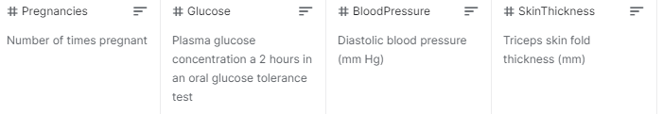
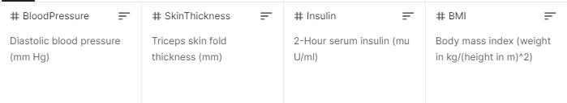
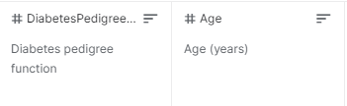
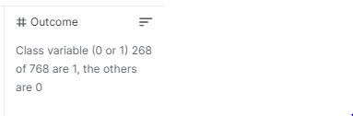
Code based Examples
Perceptron Training
Diabetes Condition Prediction
Source: https://www.kaggle.com/uciml/pima-indians-diabetes-database

Slide 16
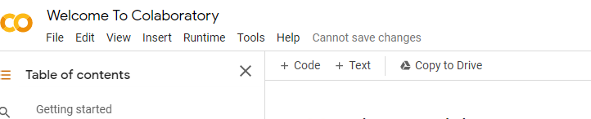

Code Example : Part 1
Open a browser
Navigate to https://colab.research.google.com/notebooks/intro.ipynb
Sign in with a google account
(use indranilduttaml1@gmail.com/TestML001)
- Click on the code link on the top ribbon to get section as below

Slide 17


Code Example : Part 2
Paste Code from file : ‘File Upload.txt’
Click on the run button next to it
Upload file ‘3D_data_new.xlsx’
Click again for another code section from top
Paste Code from file : ‘Perceptron Training’
Click on the run button next to it

Slide 18
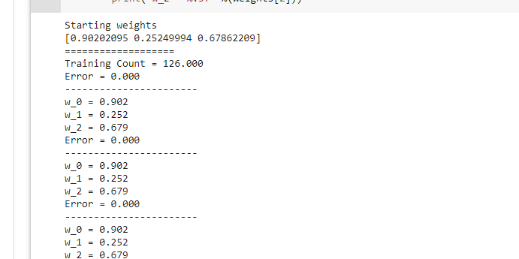
Code Example : Part 3
Results like
Things to see
Weights are randomized at first
Then they become constant
Things to try out – change epoch, change learning rate.

Slide 19
Code Example : Part 4
New Example : Diabetes Outcome
Upload data file by using code as before
Upload file ‘pima-indians-diabetes.xlsx’
Open a code section as before.
Paste code from file ‘Diabetes Prediction.txt’
Click on the run button next to it

Slide 20
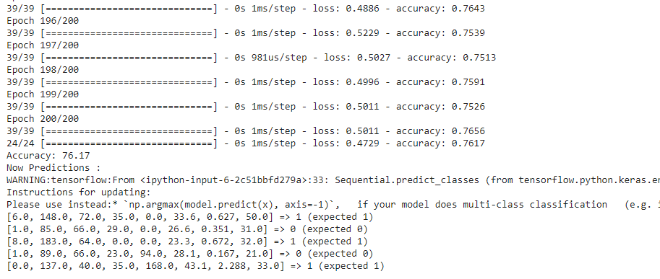
Code Example : Part 5
Results
Things to check
Accuracy and prediction results.
Things that can be changed.
Epoch and batch sizes and see accuracy.

Slide 21
PC based Tools

Slide 22
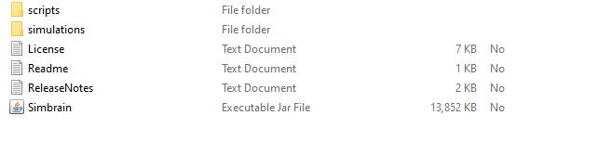
PC Based Example : Part 1
Open a browser
Navigate to http://simbrain.net/Downloads/downloads_main.html
Download Simbrain 3.04
Extract the zip file to get
Click on the Simbrain Executable Jar File.

Slide 23
PC Based Example : Part 2
Basic Backpropagation model for pattern recognition
Input will be
1,0,0,0
0,1,0,0
0,0,1,0
0,0,0,1
Output will be
0,0,0,1
0,0,1,0
0,1,0,0
1,0,0,0

Slide 24
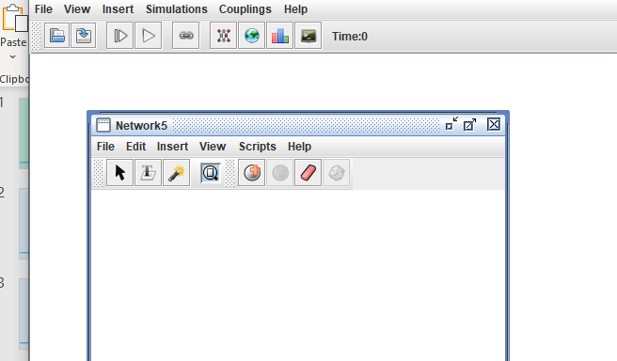
PC Based Example : Part 3
Click on Insert New Network to get as below

Slide 25
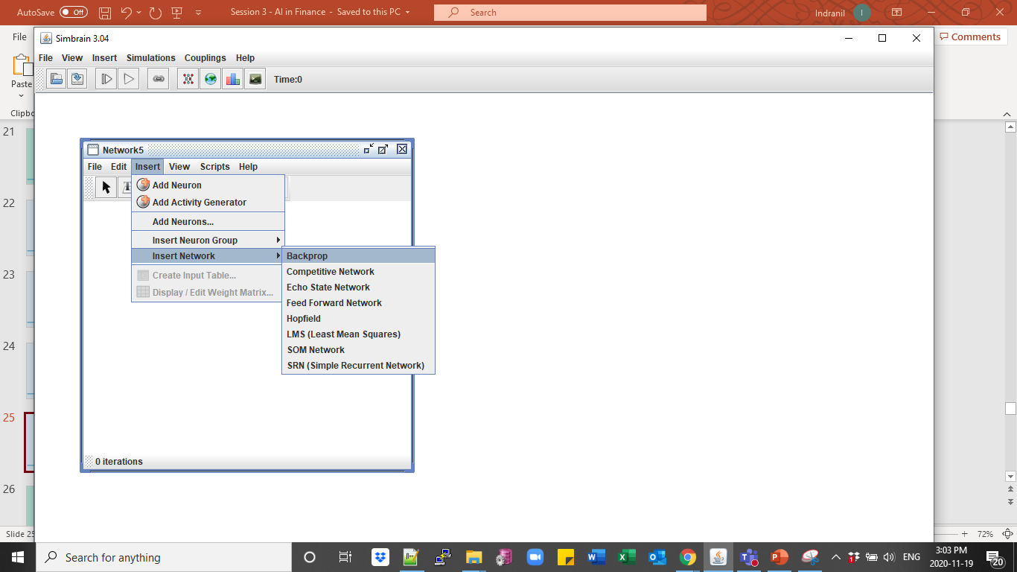
PC Based Example : Part 4
Get the Back Propagation menu as below

Slide 26
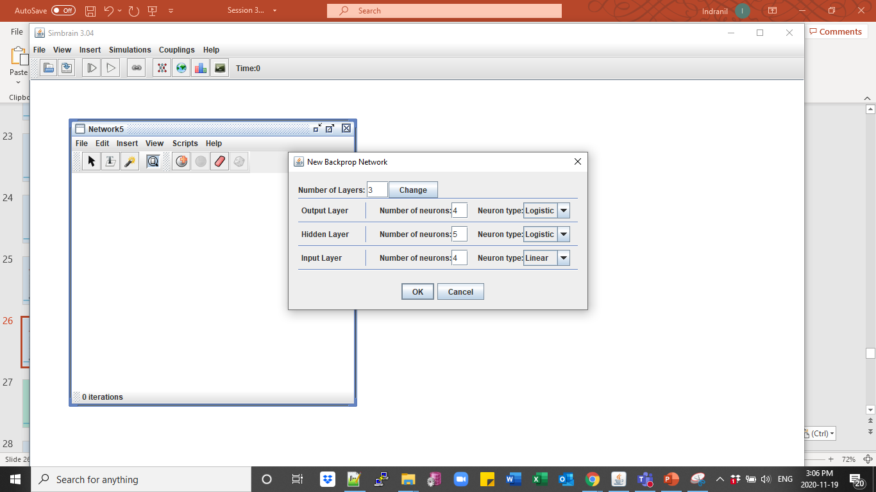
PC Based Example : Part 5
Choose network details as below . Then click OK.

Slide 27
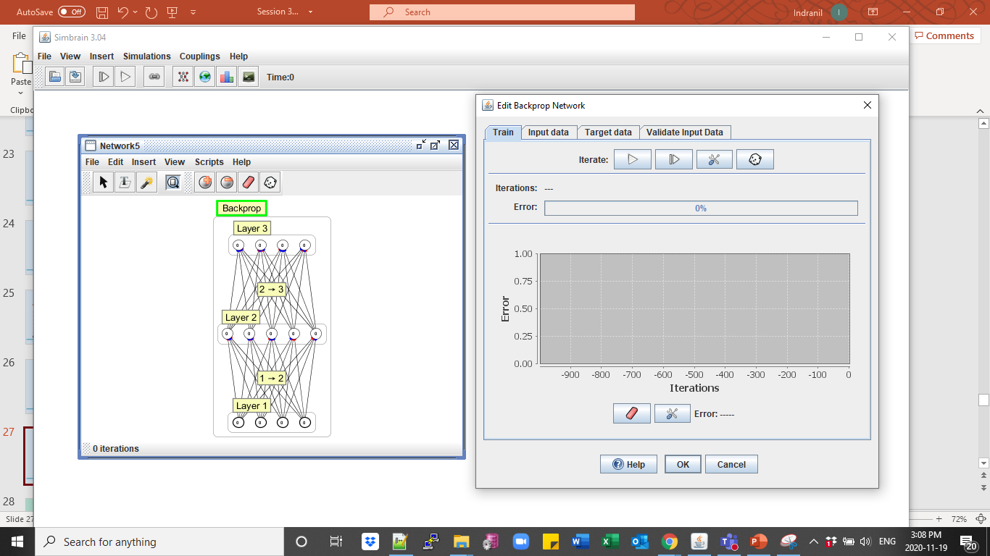
PC Based Example : Part 6
Choose the Backpropagation tab and right click to open the edit window

Slide 28
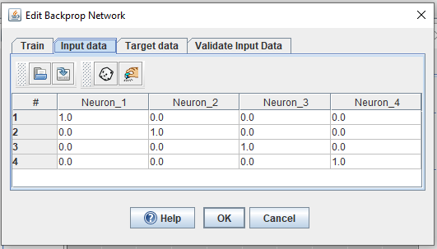
PC Based Example : Part 7
Change input and target data by selecting the tabs and changing column values
Delete the last rows by selecting and right click of mouse.

Slide 29

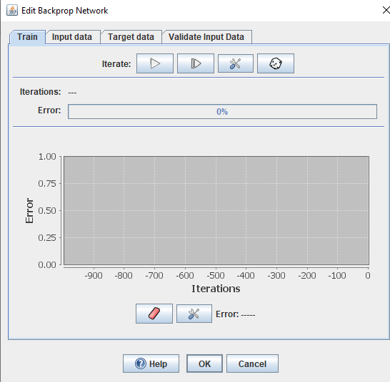
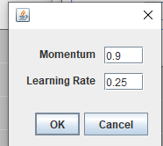
PC Based Example : Part 8
Run training using the Train tab. You can change parameters also by clicking on the icon..

Slide 30
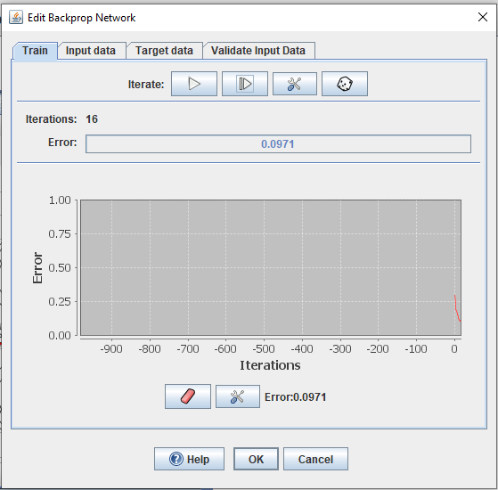
PC Based Example : Part 9
Train the model using iterations. The error will reduce on subsequent iterations.

Slide 31
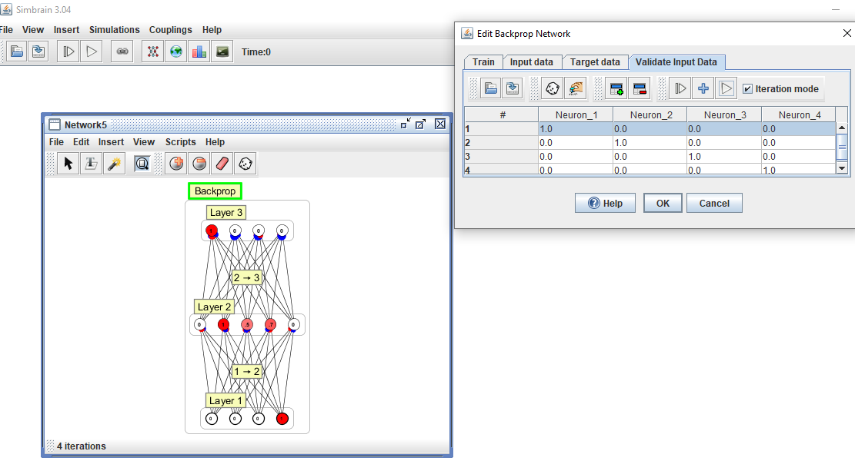
PC Based Example : Part 10
Validate results from the training

Slide 32
AI platforms

Slide 33
AI platform based Example : Part 1
Business Case: Predict outcome of marketing campaign for a bank
Data set from: https://archive.ics.uci.edu/ml/datasets/Bank+Marketing
Problem Statement
The data is related with direct marketing campaigns of a Portuguese banking institution. The marketing campaigns were based on phone calls. Often, more than one contact to the same client was required, in order to access if the product (bank term deposit) would be (or not) subscribed.
Analyzed in
S. Moro, R. Laureano and P. Cortez. Using Data Mining for Bank Direct Marketing: An Application of the CRISP-DM Methodology.
In P. Novais et al. (Eds.), Proceedings of the European Simulation and Modelling Conference - ESM'2011, pp. 117-121, Guimarães,
Portugal, October, 2011. EUROSIS

Slide 34
AI platform based Example : Part 2
Data set details:
Input variables:
# bank client data:
1 - age (numeric)
2 - job : type of job (categorical: "admin.","unknown","unemployed","management","housemaid","entrepreneur","student", "blue-collar","self-
employed","retired","technician","services")
3 - marital : marital status (categorical: "married","divorced","single"; note: "divorced" means divorced or widowed)
4 - education (categorical: "unknown","secondary","primary","tertiary")
5 - default: has credit in default? (binary: "yes","no")
6 - balance: average yearly balance, in euros (numeric)
7 - housing: has housing loan? (binary: "yes","no")
8 - loan: has personal loan? (binary: "yes","no")
# related with the last contact of the current campaign:
9 - contact: contact communication type (categorical: "unknown","telephone","cellular")
10 - day: last contact day of the month (numeric)
11 - month: last contact month of year (categorical: "jan", "feb", "mar", ..., "nov", "dec")
12 - duration: last contact duration, in seconds (numeric)
# other attributes:
13 - campaign: number of contacts performed during this campaign and for this client (numeric, includes last contact)
14 - pdays: number of days that passed by after the client was last contacted from a previous campaign (numeric, -1 means client was not previously contacted)
15 - previous: number of contacts performed before this campaign and for this client (numeric)
16 - poutcome: outcome of the previous marketing campaign (categorical: "unknown","other","failure","success")
Output variable (desired target):
17 - y - has the client subscribed a term deposit? (binary: "yes","no")

Slide 35
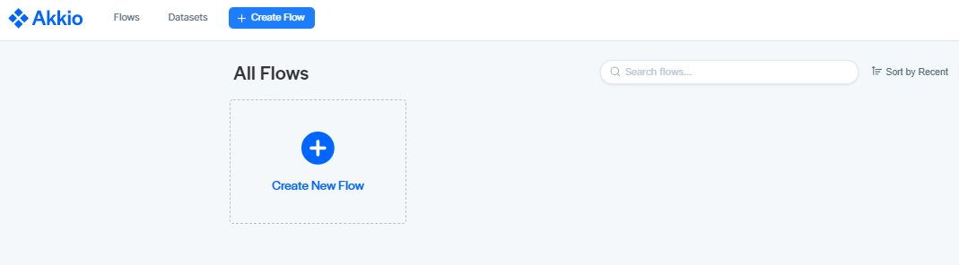
AI platform based Example : Part 3
Open a browser
Navigate to https://app.akk.io/login
Sign in with Google credentials or create an account.

Slide 36
AI platform based Example : Part 4
Flow on this platform is a end to end machine learning model
Click on ‘Create New Flow’.

Slide 37
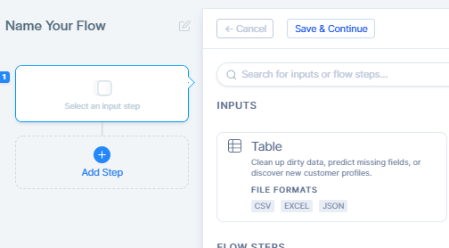
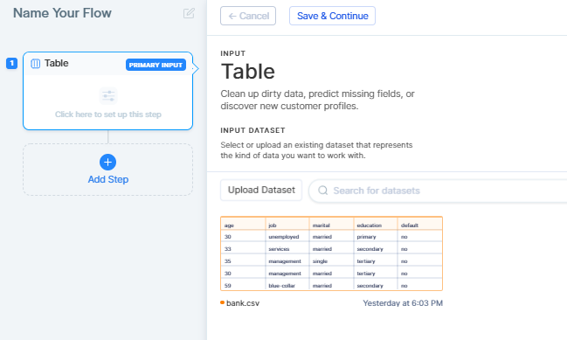
AI platform based Example : Part 5
Change name of Flow on top left
Click on Inputs -> table to upload data
Choose ‘Bank.csv’ as data source

Slide 38
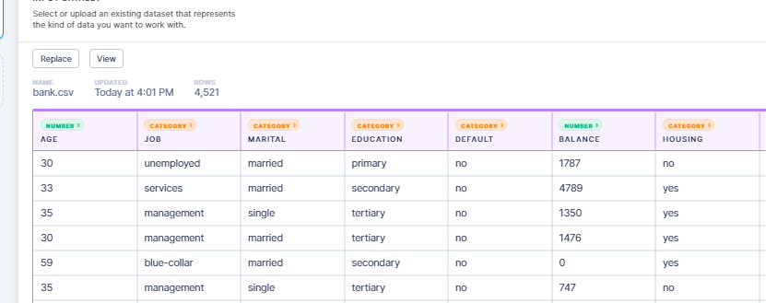
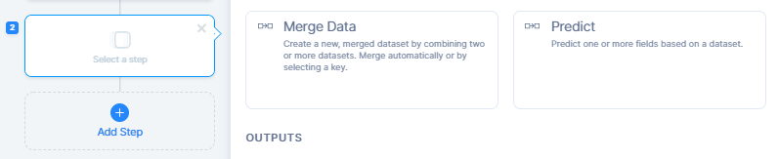
AI platform based Example : Part 6
Data is categorized as it is brought in
Choose Add Step and Predict

Slide 39
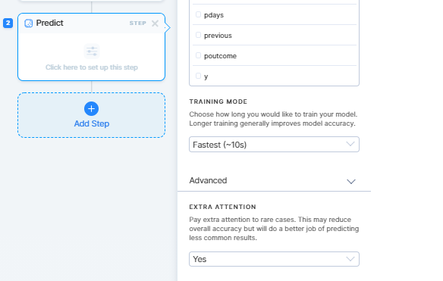
AI platform based Example : Part 7
Choose value that needs to be predicted
Choose other parameters to train the model.

Slide 40
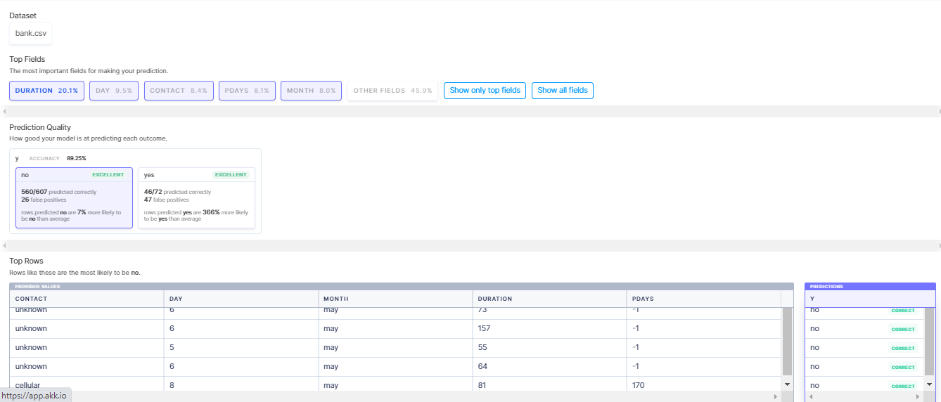
AI platform based Example : Part 8
See results. Model can be published and is accessible by a URL for individual or mass inputs

Slide 41
Session summary -------------------------------------------------------------
When neural networks are trained, it is necessary to ensure that they are not overtrained.
Overtraining would make them fit too perfectly to the training data and not to the task at hand.

Slide 42
References ------------------------------------------------------------- www.sciencedaily.com/releases/2020/11/201117144539.htm> https://www.allaboutcircuits.com/technical-articles/understanding-simple-neural-network-training-and-learning https://machinelearningmastery.com/understand-the-dynamics-of-learning-rate-on-deep-learning-neural-networks/ https://www.allaboutcircuits.com/technical-articles/how-to-train-a-basic-perceptron-neural-network/ https://machinelearningmastery.com/difference-between-a-batch-and-an-epoch/ https://machinelearningmastery.com/difference-between-a-batch-and-an-epoch/ https://blog.paperspace.com/intro-to-optimization-momentum-rmsprop-adam/ https://towardsdatascience.com/what-are-hyperparameters-and-how-to-tune-the-hyperparameters-in-a-deep-neural-network-d0604917584a#:~:text=Hyperparameters%20are%20the%20variables%20which,optimizing%20the%20weights%20and%20bias).

Slide 43
Topics for next session
Neural Networks – Practical examples

Slide 44
End of Session ------------------------------------------------------------------ Questions

